Slide 1
Domain Specific Chatbot :
Dr. Bot, Your Personalized Medical Guide
Group Members:
Carlos Lopez, Vaidehi Pawar, & Bibianca Baarh

Slide 2
Project
Interpretation
& Goals
In this project, we have created a chatbot that helps answer medical questions using information from the Gale Encyclopedia of Medicine. The chatbot was designed to understand and respond to questions about medical conditions, treatments, and possible diagnoses.
The goal was to have a working chatbot that could assist users with medical questions and provide helpful information from the Gale Encyclopedia of Medicine.
Notes:
Talk about how we interpreted the project
What was our purpose for the chatbot
Our purpose was always to make a chatbot that could be impactful and useful for a specific audience
How we found our data (Medical Encyclopedia)
How purpose led our design and to RAG

Slide 3
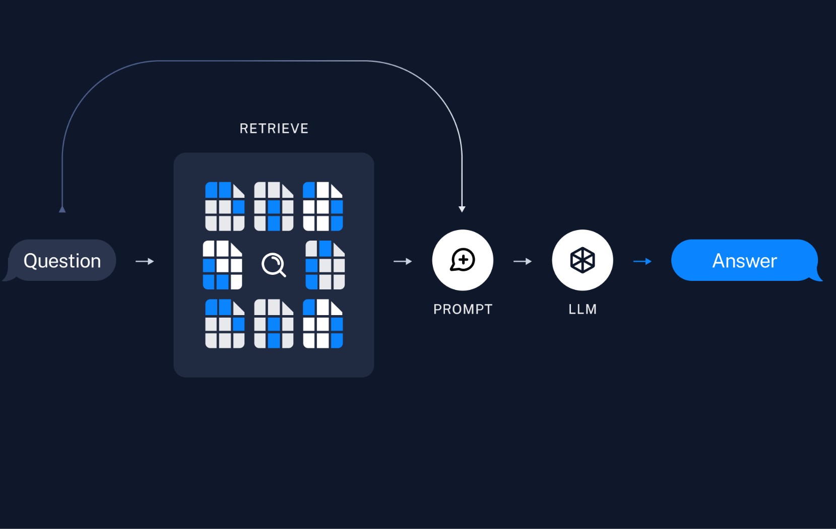
Powering our Chatbot: RAG
RAG stands for Retrieval-Augmented Generation. It involved two parts: indexing data into an “ingestion pipeline”, and retrieving relevant context from index based on a question to generate and answer.
We define a RAG pipeline/chain to prompt a LLM to answer questions for document-based data by retrieving relevant information from indexed storage. The user query is used for both text retrieval and as a prompt input.
Credit: LangChain

Slide 4
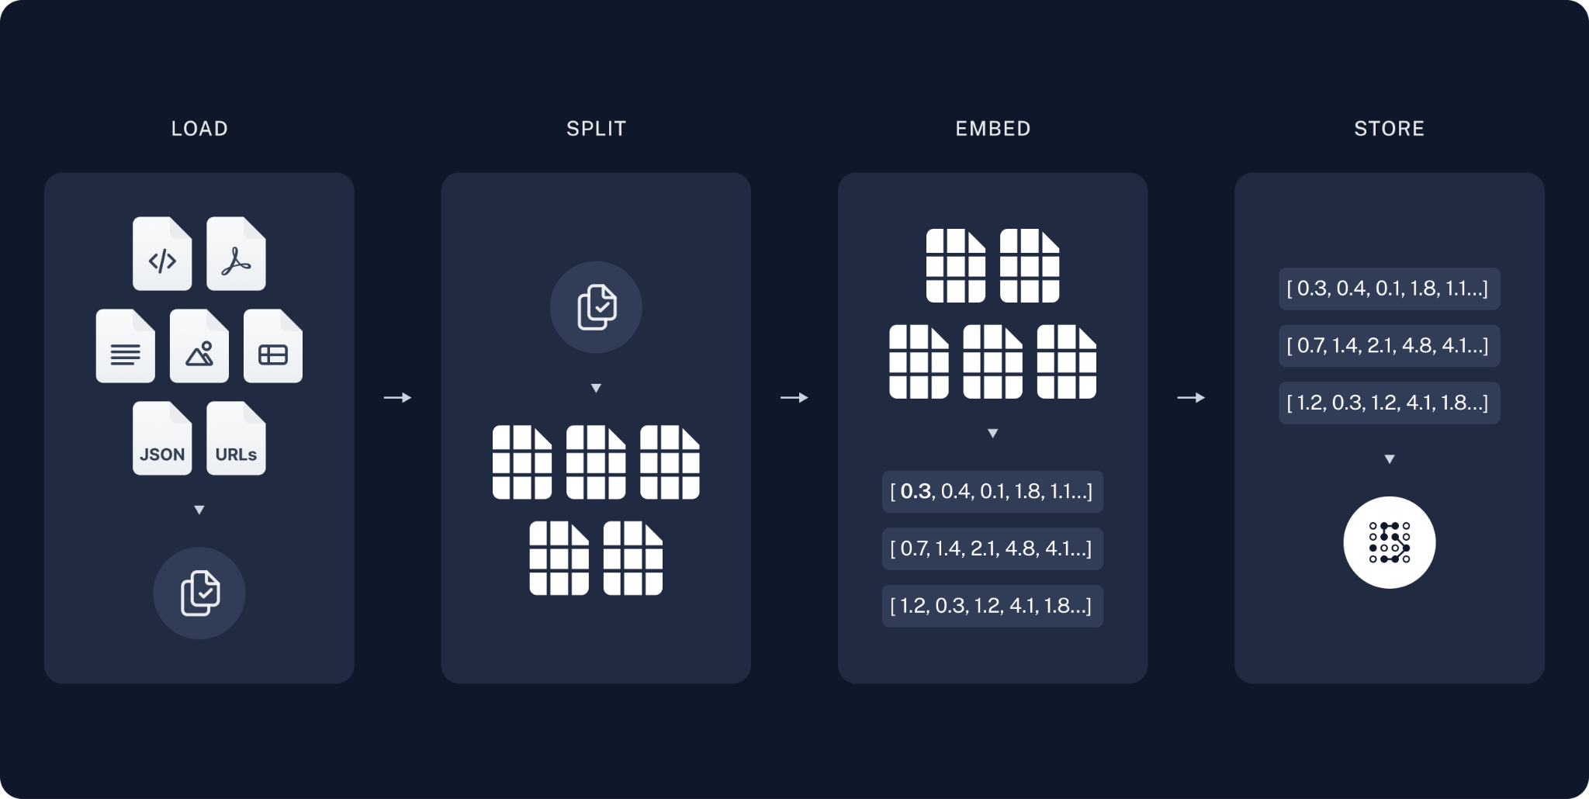
Indexing Documents into Vector Database
Credit: LangChain
Notes:
Talk about how the vector database works
A document is loaded and text is extracted into a list with text per page and metadata including document name and page #
The text is split into chunks
An embedding model maps text to a vector space
What specific libraries and tools did we use
PyPDFLoader from LangChain for document loading
CharacterTextSplitter from LangChain for chunking document
SentenceTransformerEmbeddings from LangChain for loading embedding model to map text to vector space
Chroma from Langchain_community for our vector database to store embeddings and retrieve splits
Installing Ollama for loading Mistral LLM and being able to locally run
LangChain_Ollama for using the Mistral LLM for RAG pipeline/chain usage
ChatPromptTemplate from Langchain_Core for writing a custom prompt to LLM
RetrievalQA from LangChain to define the RAG pipeline with LLM, VectorRetriever, and Prompt as input
Gradio for deploying custom interface for chatbot functionality

Slide 5
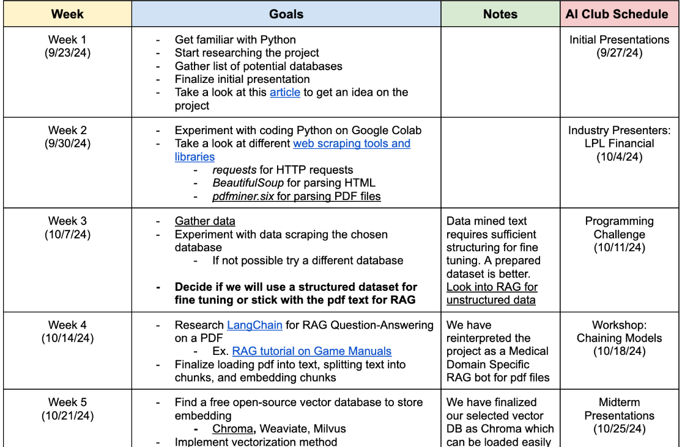
PROJECT TIMELINE

Slide 6
PROJECT ROADMAP
Conduct research to analyze the project requirements and scope
Set project goals and expectations
Choose academic-related document and extract text
Split text into sizable chunks
Load an embedding model and store embeddings into a vector database
Load a LLM and define RAG pipeline/chain
Create chatbot model functionality
Evaluate chatbot with prompts to ensure accurate responses
Record results and prepare for final presentation

Slide 7
Libraries/Tools Used
PyPDFLoader from LangChain for document loading
CharacterTextSplitter from LangChain for chunking document
SentenceTransformerEmbeddings from LangChain for loading embedding model to map text to vector space
Chroma from Langchain_community for our vector database to store embeddings and retrieve splits
Installing Ollama for loading Mistral LLM and being able to locally run
LangChain_Ollama for using the Mistral LLM for RAG pipeline/chain usage
ChatPromptTemplate from Langchain_Core for writing a custom prompt to LLM
RetrievalQA from LangChain to define the RAG pipeline with LLM, VectorRetriever, and Prompt as input
Gradio for deploying custom interface for chatbot functionality

